Slide 1
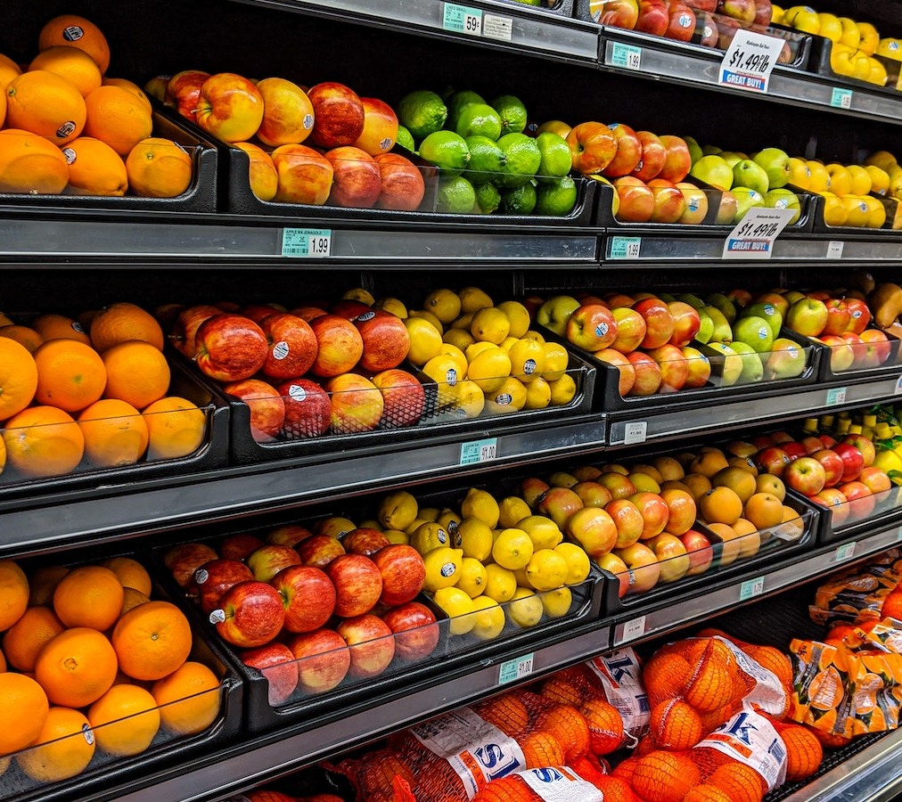
Marketing Research:
How Grocery Prices Effect Generations
Kristina Burgess, John Dames, Manda Egbert, Elijah Weis
Notes:
State names and give a little background? (year, major, why we each did this project?)

Slide 2




TRUMAN STATE UNIVERSITY TEAM
Kristina Burgess
John Dames
Manda Egbert
Elijah Weis

Slide 3
PRESENTATION OVERVIEW
01
INTRODUCTION
02
BACKGROUND
03
METHODOLOGY
04
KEY FINDINGS
05
IMPLICATIONS
06
CONCLUSION
& APPENDIX
Notes:
Introduction + Background - Elijah
Methodology + qual control - John
Key findings - Manda
Results + Conclusion - Kristina

Slide 4

01
INTRODUCTION

Slide 5
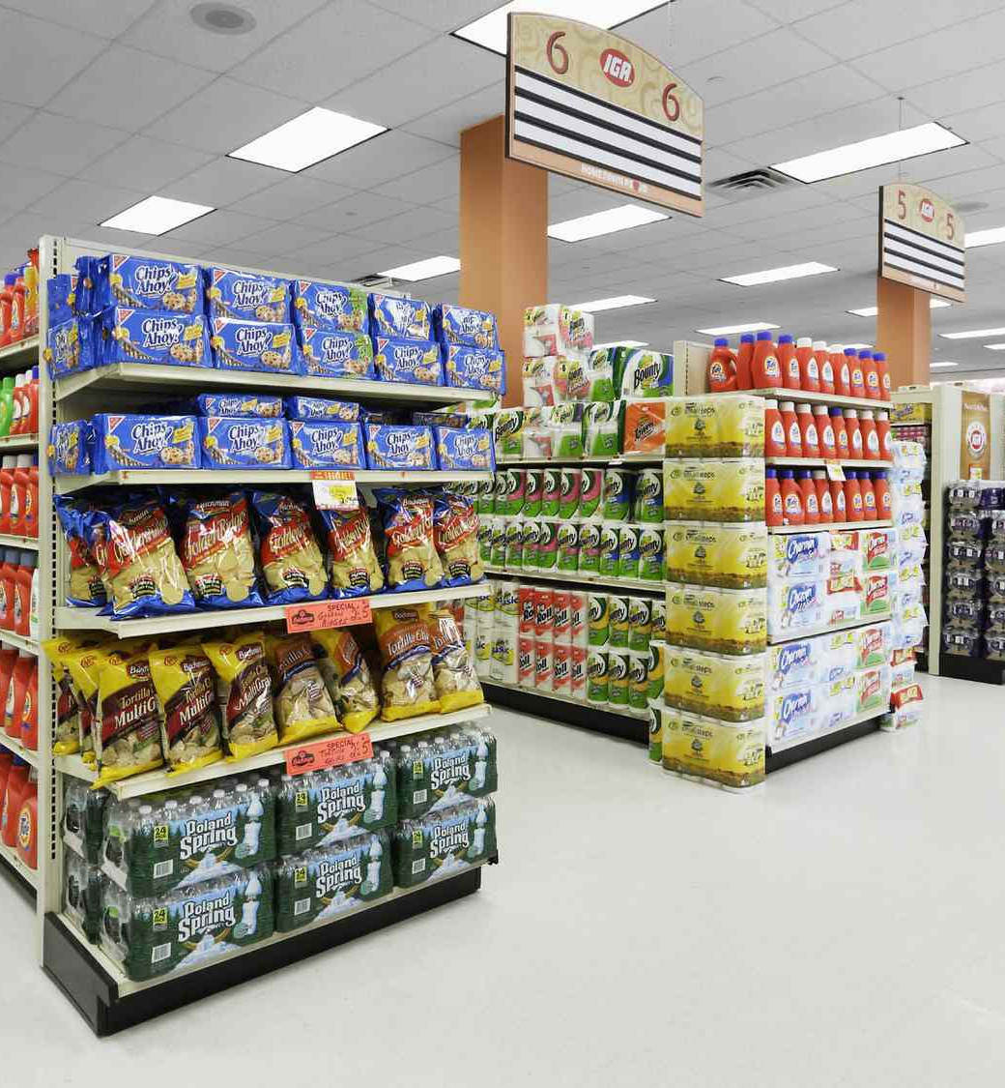
Research Question
How are rapidly rising prices at grocery retail impacting the way consumers shop differently across generations?

Slide 6
How should we attack this problem?
Did we have any prior knowledge to bring to this topic?
What kind of research would need to be done to gain a complete understanding?
Where would our research come from?
How would we be restricted by things like having no budget for research?

Slide 7

Problem
Statement
Rising grocery prices are a concern across demographics
Allocate more income towards necessities
Reduced flexibility in spending
Worsen existing disparities and food insecurity
Notes:
Rising grocery prices are a growing concern for households across demographics. They have to allocate more of their income towards basic necessities and reducing flexibility in spending habits. This can potentially worsen the already existing disparities and food insecurity among vulnerable communities.

Slide 8
KEY RESEARCH QUESTIONS
1
2
3
How does each generation perceive the effects on the others?
How does generation affect strategies used after prices increased?
Is there statistical evidence that generation can predict responses to increasing grocery prices?
4
5
How does each generation budget for grocery shopping?
What factors do each generation prioritize when choosing a store?
Notes:
List them all?
How are rapidly rising prices at grocery retail impacting the way consumers shop differently across generations?
How do different generations prioritize their spending on grocery items, and what factors influence their decisions?
Are older generations more likely to react to price changes than younger generations?
How do the demographic characteristics of consumers, such as income and household size, affect their response to rising grocery prices?
How does the emergence of alternative food shopping channels, such as farmer's markets and community-supported agriculture, affect the behavior of consumers across different generations in response to rising grocery prices?
Have people begun to move away from fresh produce towards frozen options and does this differ between generations?
Are certain generations choosing fast food options over grocery items to compensate for the rise in prices?
Actual Research Questions
How are rapidly rising prices at grocery retail impacting the way consumers shop differently across generations?
How do different generations prioritize their spending on grocery items, and what factors influence their decisions?
Are older generations more likely to react to price changes than younger generations?
How do the demographic characteristics of consumers, such as income and household size, affect their response to rising grocery prices?
How does the emergence of alternative food shopping channels, such as farmer's markets and community-supported agriculture, affect the behavior of consumers across different generations in response to rising grocery prices?

Slide 9
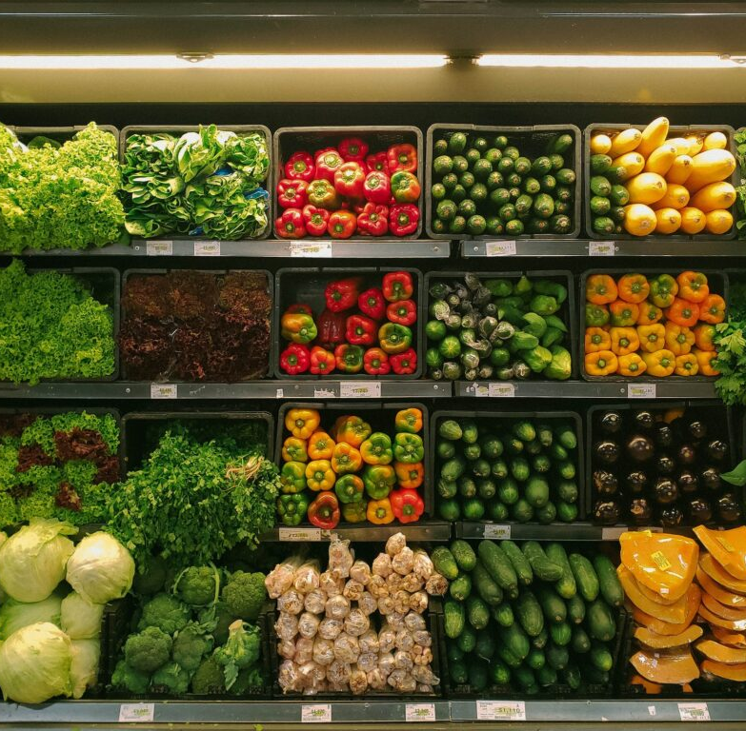
02
BACKGROUND

Slide 10
Importance
Motivation
We all had a relative understanding of the problems being faced due to rising grocery prices
We also understood that this question could directly affect ourselves, friends, or family
Motivation came from the opportunity to learn and gain experience in an area we had not explored yet a
Most of us will be graduating very soon and this research project brings us a lot closer to what some of our real world experiences might look like
Notes:
Relevance and Importance: Understanding how different generations are dealing with the rise in grocery prices is crucial to addressing this problem, as it will enable us to develop effective strategies to mitigate its impact. Our findings will provide important insights for policymakers, retailers, and consumers, as they navigate food affordability in the current economy.

Slide 11
Interest Statement
Strengthen and test our capabilities to transform a research question into valuable insights
Gain confidence in cooperation with peers, communicate with clients, and effectively present findings
Opportunity to combine our specialties in data, research, creativity, project management, and experience in the retail industry
Solidify our strengths and address our weaknesses as we head toward graduation and future careers

Slide 12

03
METHODOLOGY
Notes:
At the end of methodology add the gender distribution?

Slide 13
Challenges
Location
Rural Missouri
Limited access to diverse local sample
Resources
Smaller Missouri university
Limited secondary research within school catalogs
Budget
No excess money to spare for this
Cyber Attack
Breach found in system preventing students from using our school accounts and on campus wi-fi
Have been locked out this past week
Lost access to statistical software
Notes:
Mention how we were originally gonna be with google forms

Slide 14
Information Sources
Survey
Interviews
Secondary Sources
Quantitative & Qualitative
Qualitative
USDA
Reddit
Gale Onefile

Slide 15
Literature Review
Gale Onefile: Telegraph Online
USDA CPI
Gale Onefile: National Hog Farmer
Reddit
25 billion pound plunge in spending for Gen Z
6 in 10 Gen Z to cut spending on food & clothing
4 in 10 boomers for that same stat
Eggs saw 32.2% price change in 2022
Other than beef, every other food saw % change increase from 2021 to 2022
30% Gen Z seeking groceries from food pantry or charity
Only 19% of millenial and gen X
7% of boomers
Sub $100 budget before
Now closer to $140-$160 range

Slide 16
The Interview
Qualitative info
Asked family & friends
Received variety of generations
5 gen z
3 millennial
3 gen x
1 boomer
2 silent generation
Open ended questions

Slide 17
Results From the Interview
Guided survey questions
Reassured: yes, people have noticed price increases
Helped narrow down common strategies
Received several additional money-saving strategies for grocery shopping
Trend of switching grocery stores as prices rose
Showed preference of generic brands
Many noticed items such as meat and eggs rose drastically
Notes:
Mention how political people were

Slide 18
The Survey
Qualitative & Quantitative
Partnered with EMI for sampling
Sample
Gen Z: 18-26
Millennials: 27-42
Gen X: 43-58
Baby Boomers: 59 and above
Requirements:
Over the age of 18
Shop at a grocery store within the last month
Received demographics like gender, generation, salary
Received consistent amount between the generations
125 each
Quantitative data to sort through on R
Multiple choice, scaling, open ended
Notes:
We created the survey & questions, then they translated it to a program that can convert the findings to an easy finding

Slide 19
Utilizing the Data
Quantitative
Received raw data in CSV file after completion of survey
Cleaned the data
Converted data into spreadsheet
Utilized R & Minitab
Graphs
Regressions
Distributions
Qualitative
Finding key words
Looking for commonalities between respondents

Slide 20
Quality Control
Had over the 500 expected responses to help compensate
Found people that sped through survey
Saw average time to finish
Eliminated accordingly
Searched for & eliminated gibberish answers
Random letters
Repeated phrases
Answers not aligning with question
Looked for logical outliers
Budgets that vastly surpassed their salary
Anything outside of 3 standard deviations from the mean

Slide 21
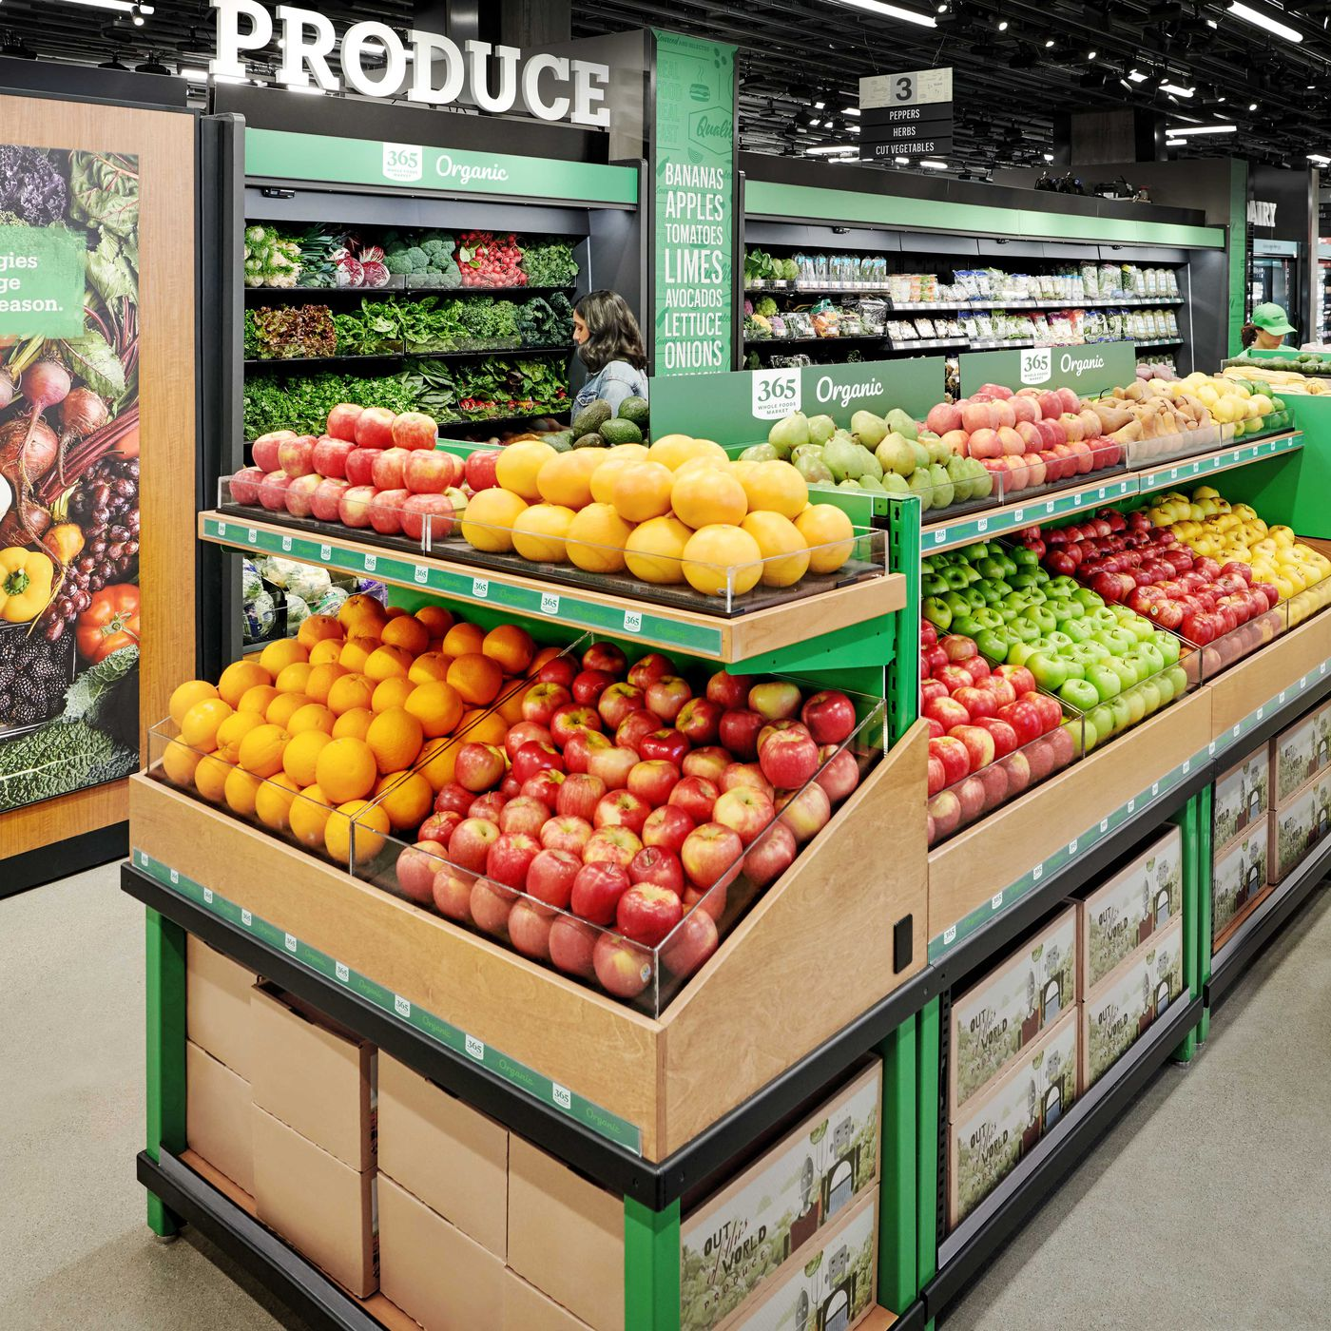
04
KEY FINDINGS
Notes:
Should key finding be before or after results?

Slide 22
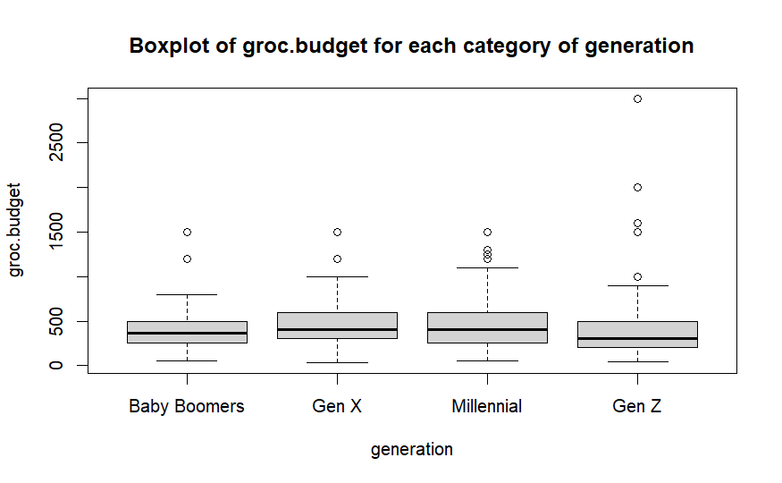
How does each generation budget for grocery shopping?
Monthly Grocery Budget Distribution
Grocery Budget Distribution by Generation
Grocery Budget ($)
$392.42
$455.73
$475.52
$451.65
Generation

Slide 23
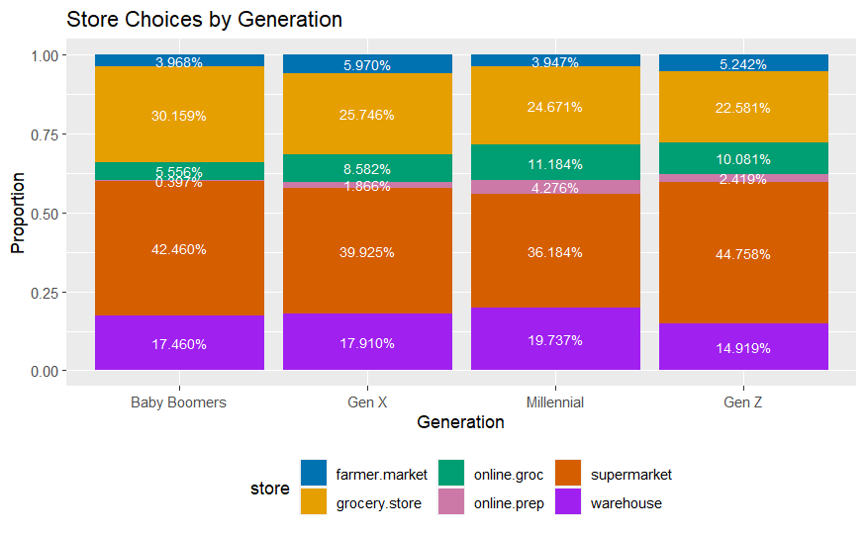

Does each generation favor certain stores?
Farmer’s Market
Grocery Store
Online Grocery Store
Online Dinner Prep
Supermarket
Warehouse
Supermarket
Warehouse

Slide 24
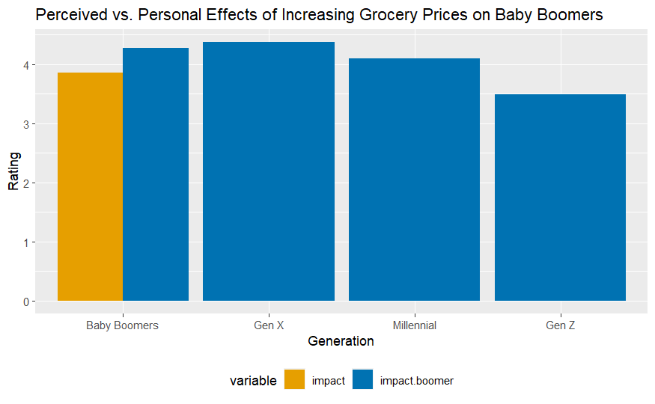

Perceived vs. Personal Effects of Increasing Grocery Prices
Perceived
Personal

Slide 25
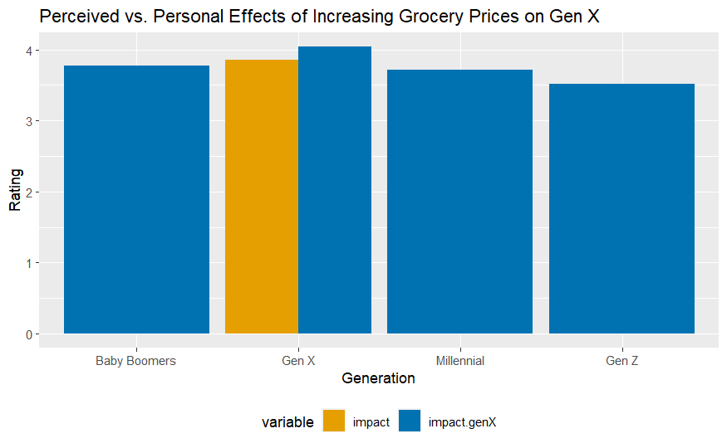
Perceived vs. Personal Effects of Increasing Grocery Prices
Perceived
Personal

Slide 26
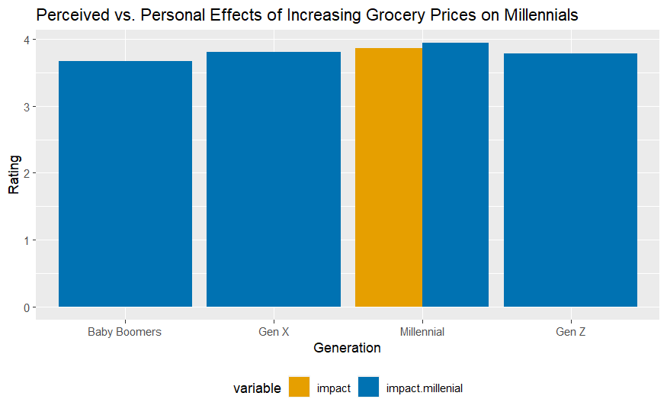
Perceived vs. Personal Effects of Increasing Grocery Prices
Perceived
Personal

Slide 27
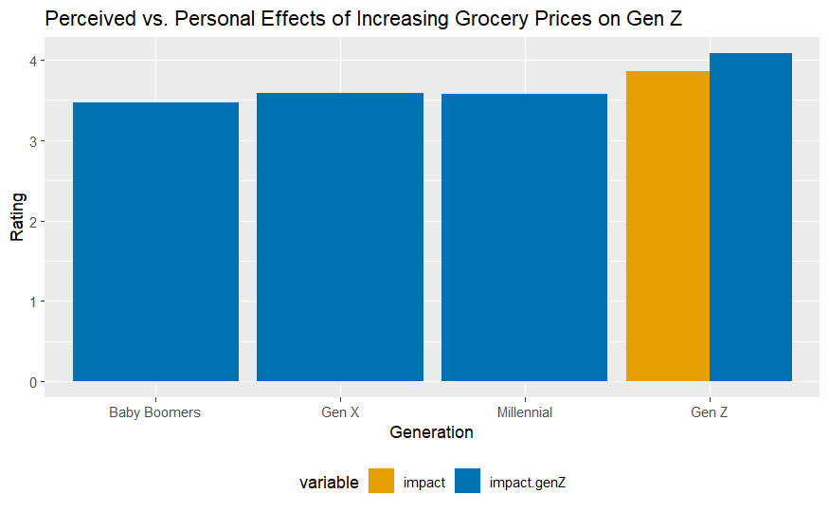
Perceived vs. Personal Effects of Increasing Grocery Prices
Perceived
Personal

Slide 28
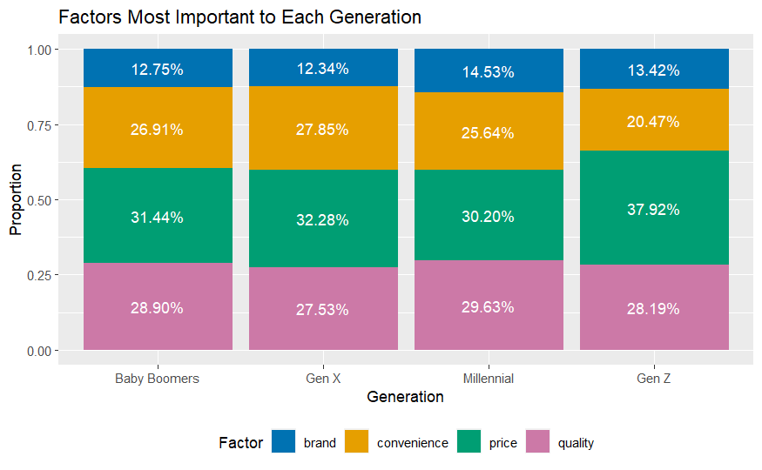
What factors do each generation prioritize when choosing a store?
Convenience
Quality
Brand
Price

Slide 29
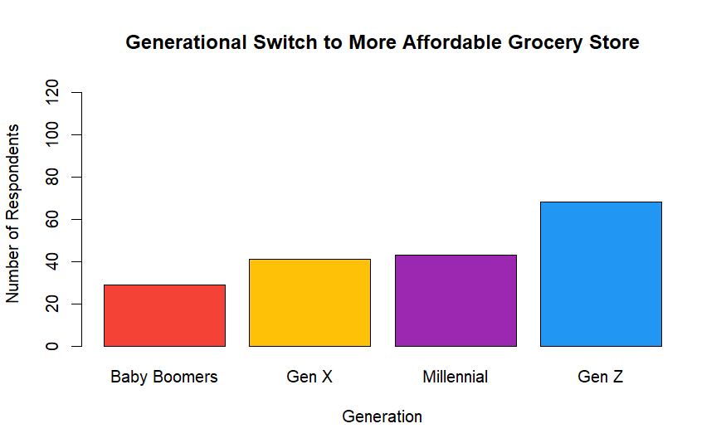
How does generation affect strategies used after prices increased?
Money-Saving Strategies

Slide 30
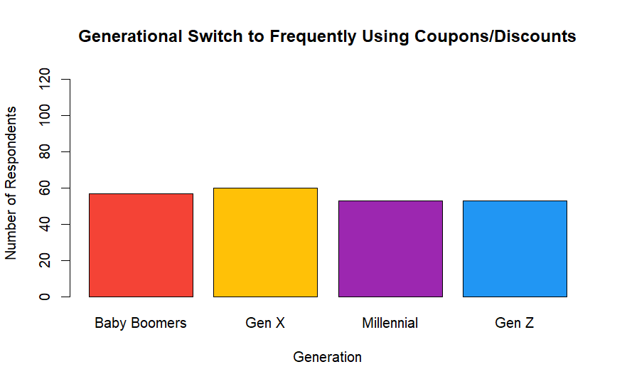
How does generation affect strategies used after prices increased?
Money-Saving Strategies

Slide 31
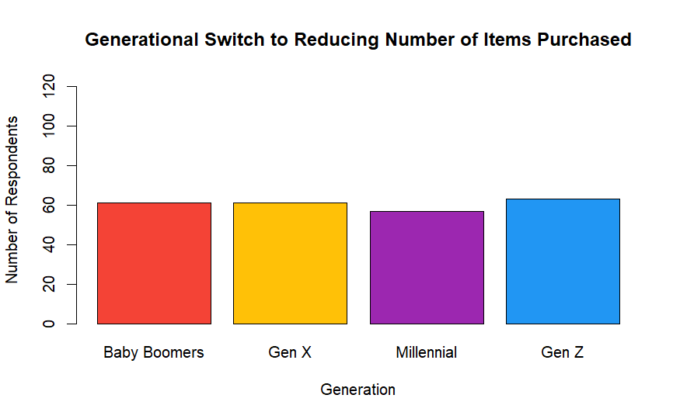
How does generation affect strategies used after prices increased?
Money-Saving Strategies

Slide 32
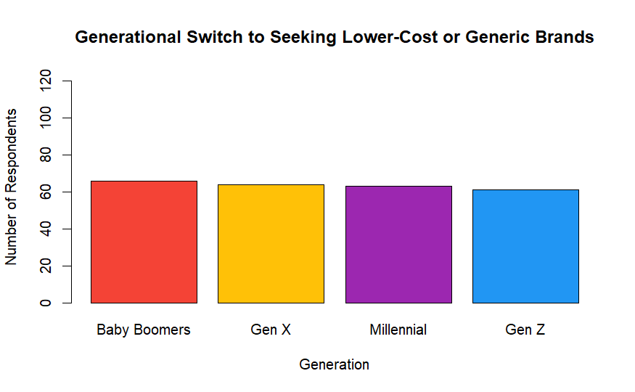
How does generation affect strategies used after prices increased?
Money-Saving Strategies

Slide 33
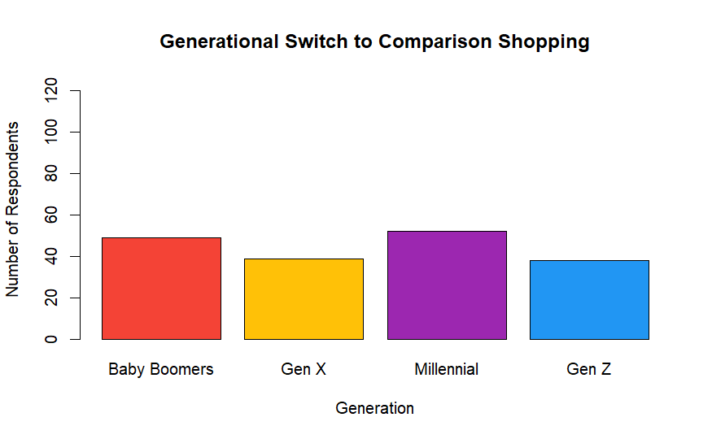
How does generation affect strategies used after prices increased?
Money-Saving Strategies

Slide 34
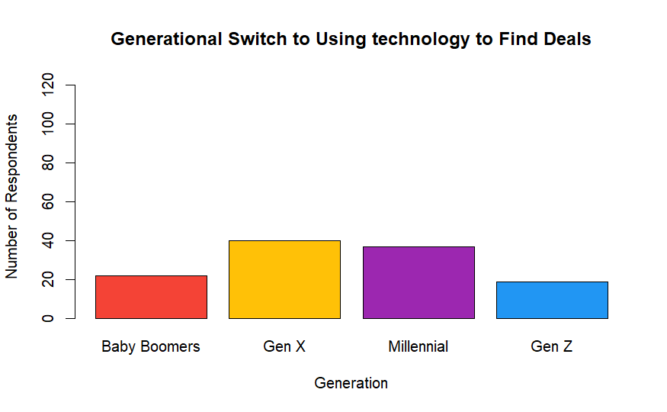
How does generation affect strategies used after prices increased?
Money-Saving Strategies

Slide 35
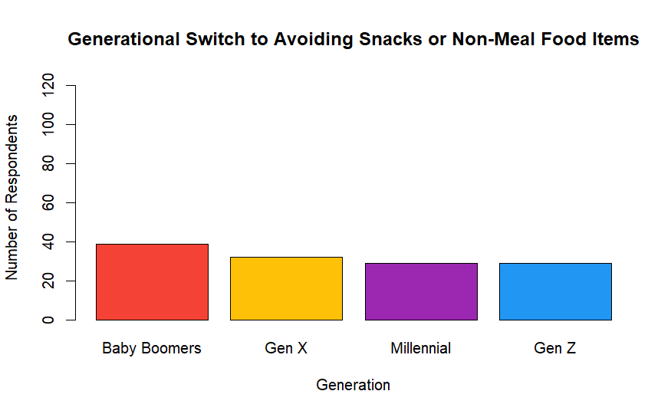
How does generation affect strategies used after prices increased?
Money-Saving Strategies

Slide 36
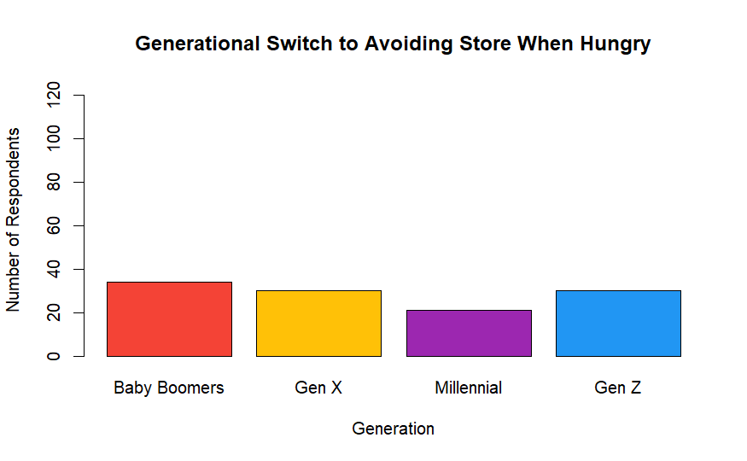
How does generation affect strategies used after prices increased?
Money-Saving Strategies

Slide 37
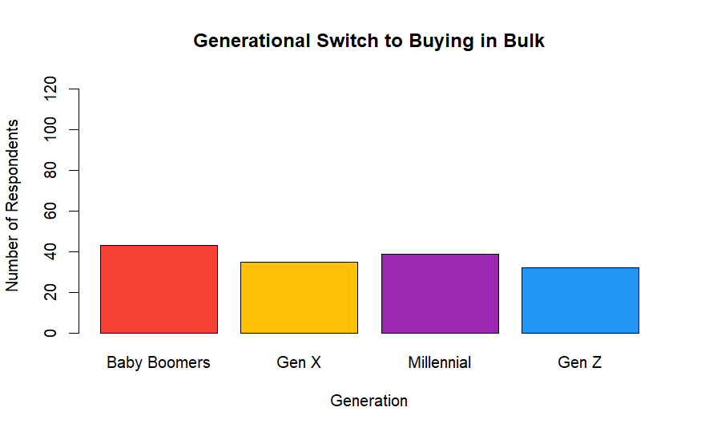
How does generation affect strategies used after prices increased?
Money-Saving Strategies

Slide 38
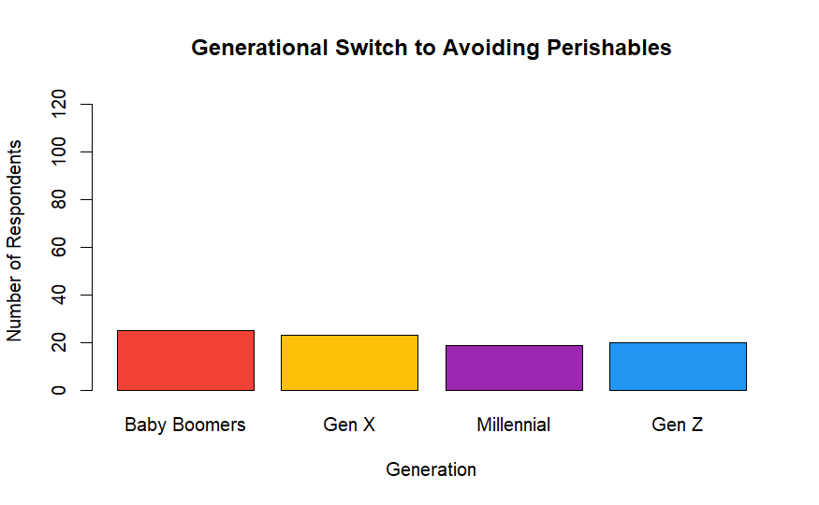
How does generation affect strategies used after prices increased?
Money-Saving Strategies

Slide 39
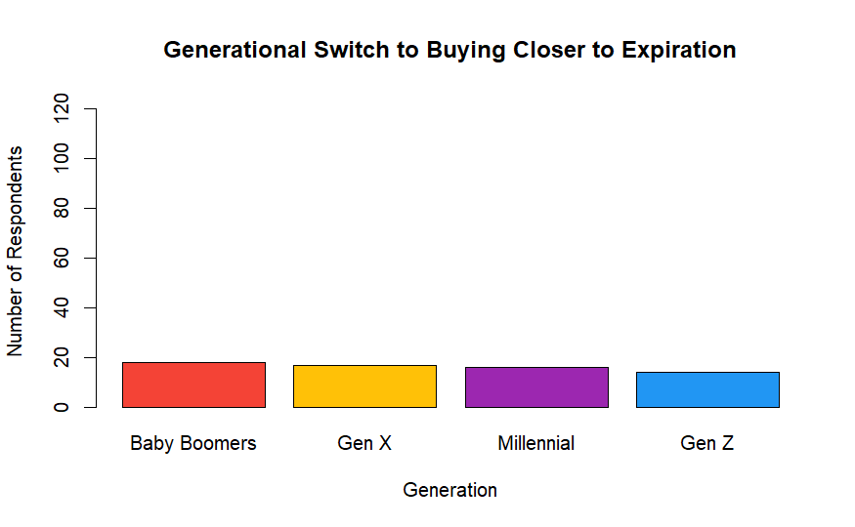
How does generation affect strategies used after prices increased?
Money-Saving Strategies

Slide 40
Is there statistical evidence that generation can predict responses to increasing grocery prices?
Multiple Linear Regression
Strong P-Values, below 0.01
Evidence that generation can predict:
Household size
Use of an online grocery service
Level of concern for prices
Likeliness of mealing planning
Very weak R-Squared, below 0.10
Cannot conclude that the evidence is meaningful

Slide 41
What do generations attribute the increase in grocery prices to?
Inflation
Baby Boomer | 25%
Gen X | 31%
Millennial | 43%
Gen Z | 40%
COVID
Baby Boomer | 13%
Gen X | 10%
Millennial | 5%
Gen Z | 6%
Government/President
Baby Boomer | 22%
Gen X | 15%
Millennial | 14%
Gen Z | 6%

Slide 42
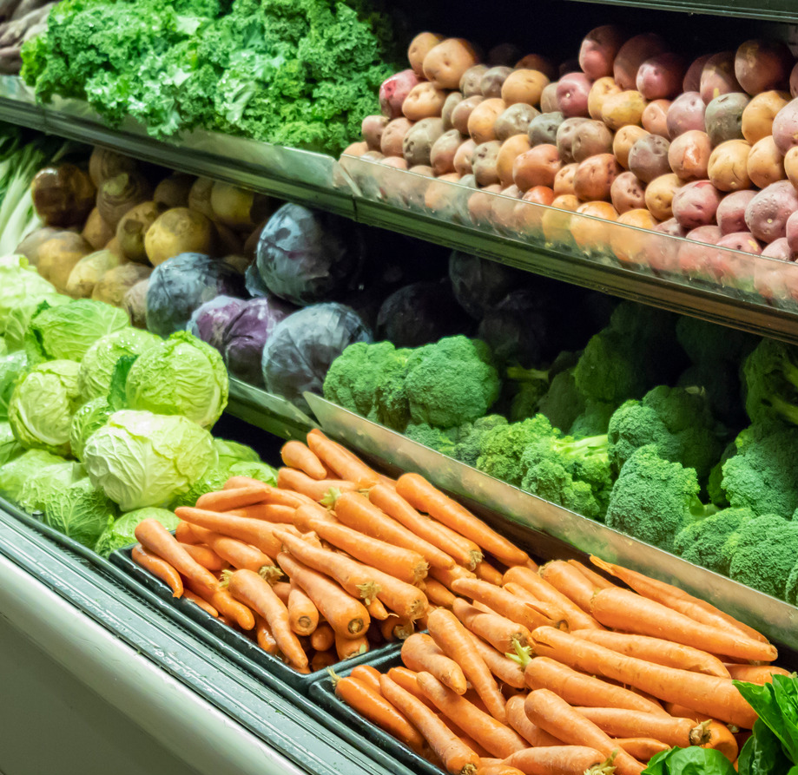
05
INTERPRETING RESULTS
Notes:
Overall findings + summary
Who we’re trying to aim this at - food retailers
Recommendations for retailers (how to get more customers)
More likely to use coupons (generation)
Interpret your results: Provide your interpretation of your results and explain what they mean in the context of your research question.
Discuss the implications of your findings: Help your audience understand the broader implications of your research by discussing the potential impact of your findings.
Conclude with a summary: Summarize your key findings and conclusions, and offer suggestions for future research.

Slide 43
Generation Summary
Generation Z
Switch to more affordable grocery stores
Prioritizes price more
Attribute grocery prices to inflation
Millennials
Comparison shopping
Highest grocery budget
Most use of online grocery services
Generation X
Using technology to find deals
Frequently using coupons/discounts
Baby Boomers
Avoiding snacks or non-meal food items
Buying in bulk
Attribute grocery prices to COVID / Government

Slide 44
Recommendations
For Grocery Retailers
Helpful to know why consumers choose them
Use that to gain more customers of the target market
Or to expand your target market to different generations
Bulk / Bargain Shopping
Stores such as Aldi and Costco
Likely to become more popular
Should take advantage of low prices / deals
More expensive stores
Such as Trader Joe’s / Whole Foods
Might need to make changes to reduce costs
Could have a decrease in customers / sales
Notes:
Discuss ideas for retailers
If they should follow certain methods to increase customers / generations
Develop online shopping services (do certain generations prefer that?
Things to implement now vs later
Ways to reduce packaging to cut costs (bulk)
Is there an increase in bulk / bargain shopping? Increase in aldi and costco
Is there a decrease in more expensive stores such as Trader Joe’s / Whole Foods

Slide 45
Future Research
Research if multiple demographics have an effect on consumer shopping habits
EX: household size, income, location, etc
Specific research for retailers
Retailers themselves could conduct research
Determine where gaps are and why
EX: Target’s online services and discounts
Younger generations - more likely to use online services
Could expand to older generations
Notes:
Any ideas?
Can discuss our limitations and ways to better go about the research if have better resources (NO)
Specific research for retailers
Focus on multiple demographics (household size, income, locations, etc)

Slide 46
06
CONCLUSION
Notes:
So that concludes our presentation, thank you for your time today. We all really enjoyed being able to experience more marketing research outside of class and this project gave the opportunity to work with real data for something that is currently impacting people today. The rise of grocery prices can easily have an effect on everyone, and it is clear that different generations are having different methods and strategies to overcome those issues.
How we overcame issues
What we got outta the project

Slide 47
Appendix

Slide 48
Interview Questions
Have you noticed an increase in grocery prices recently? If so, which items have you seen an increase in price? Fresh vegetables or fruit, frozen, meat, dairy?
How has the increase in grocery prices affected your grocery shopping habits?
Have you made any changes to the types of food you purchase due to rising prices? Buying less fresh food?
Due to rising prices, have you changed where you shop for groceries?
Do you use any strategies to save money when grocery shopping?
Do you have a specific grocery budget, and has that changed recently?
How do you think others your age are responding to an increase in grocery prices?
How has the rising cost of groceries affected your meal planning and cooking habits?
Do you think that rising grocery prices have a more significant impact on certain generations? If so, which ones and why?

Slide 49
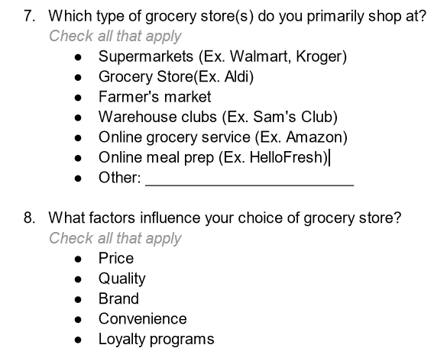
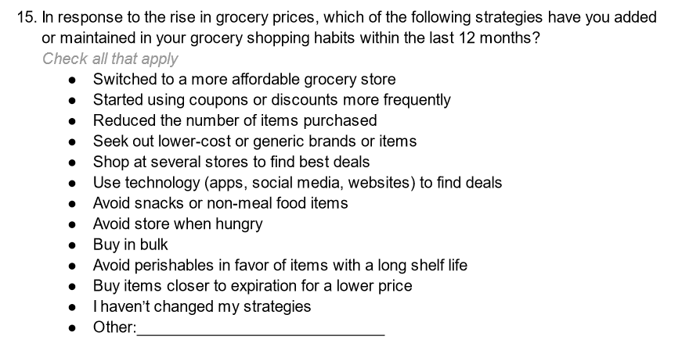
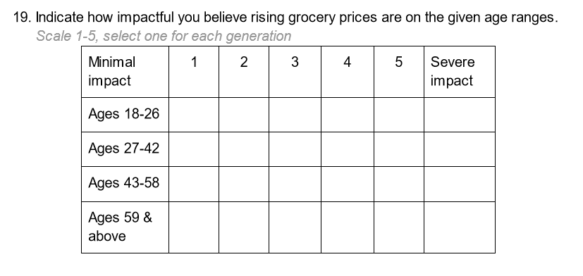
Survey Question Examples
https://docs.google.com/document/d/1pVJMAogyz9lr6ESzRBnMBg92nitsOett/edit?usp=sharing&ouid=117282032620104722509&rtpof=true&sd=true

Slide 50
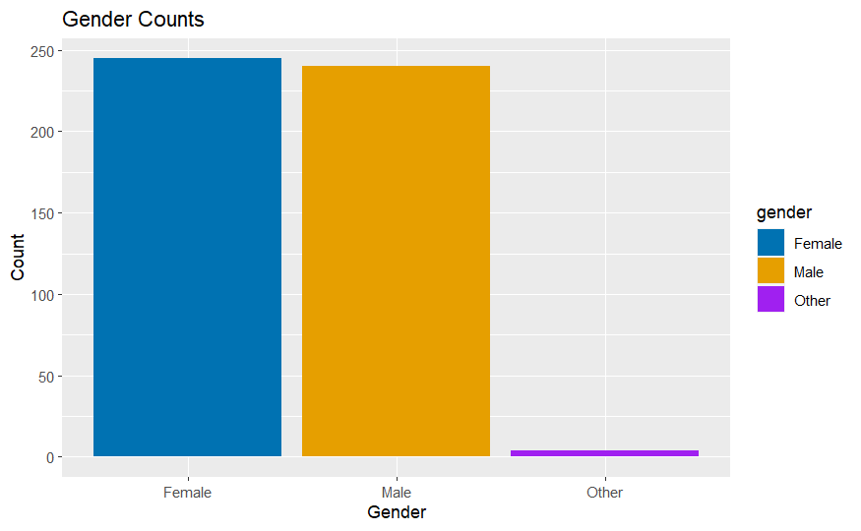
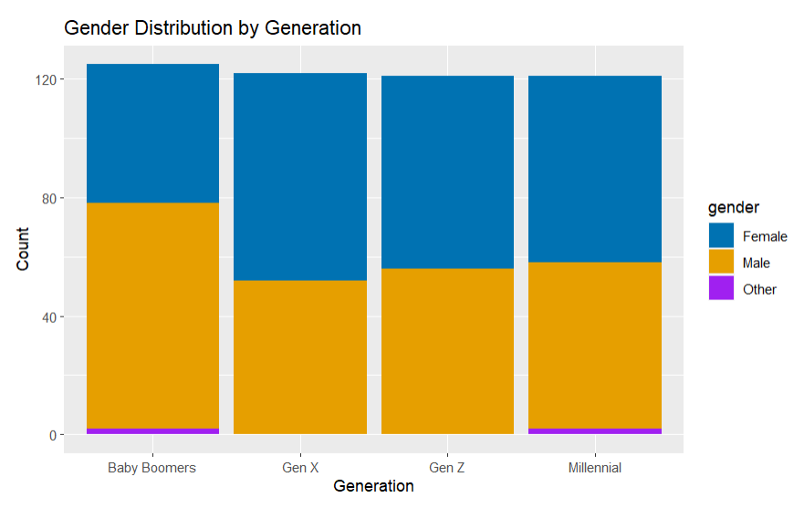
Gender Distribution
Gender
Gender

Slide 51
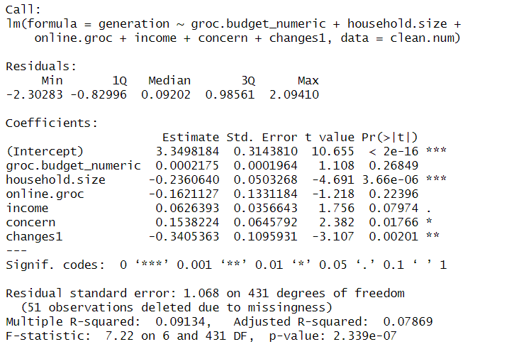

Slide 52
Citations
Food price outlook. USDA ERS - Food Price Outlook. (2023, April 25). Retrieved April 28,
2023, from https://www.ers.usda.gov/data-products/food-price-outlook.aspx
Gen Z drives £25bn plunge in spending as income shock hits; Younger generations
more likely to cut back on groceries, clothing and going out than Boomers. (2022, July 19). Telegraph Online, NA. https://link.gale.com/apps/doc/A710870627/ITBC?u=north1010&sid=ebsco&xid=0df69481
Gen Z households struggle more to put food on the table. (2022, July 14). National Hog
Farmer, NA. https://link.gale.com/apps/doc/A710197064/ITBC?u=north1010&sid=ebsco&xid=2041a79c
How much did everyones groceries go up? Reddit. (n.d.). Retrieved April 28, 2023, from
https://www.reddit.com/r/EatCheapAndHealthy/comments/tazsyb/how_much_did_everyones_groceries_go_up/

Slide 53
Thank you!

